Slide 1
Holiday Planner
Let us plan an awesome holiday for you…

Slide 2
Content
01
Motivation & Solutions
A brief introduction to traveler’s necessities
02
Happy Flow & Mockup
Blueprint of the application
Technologies Used
03
Introduction of technologies used
04
Scrapping & Data Structure
Extracting data from sites process
Business Logic
05
Algorithm approaches in recommendation by image and text and route scheduler
06
Future work
Many different adaptations, tests, and experiments

Slide 3


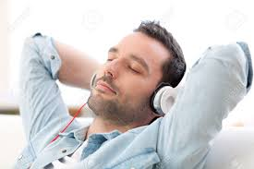
1. Motivation & Solution
“Failing to prepare is the same
as preparing to fail.”
Benjanim Franklin
A few downsides:
- countless hours spent on travel
blog research
- a lot of patience required
- searching but not finding

Slide 4
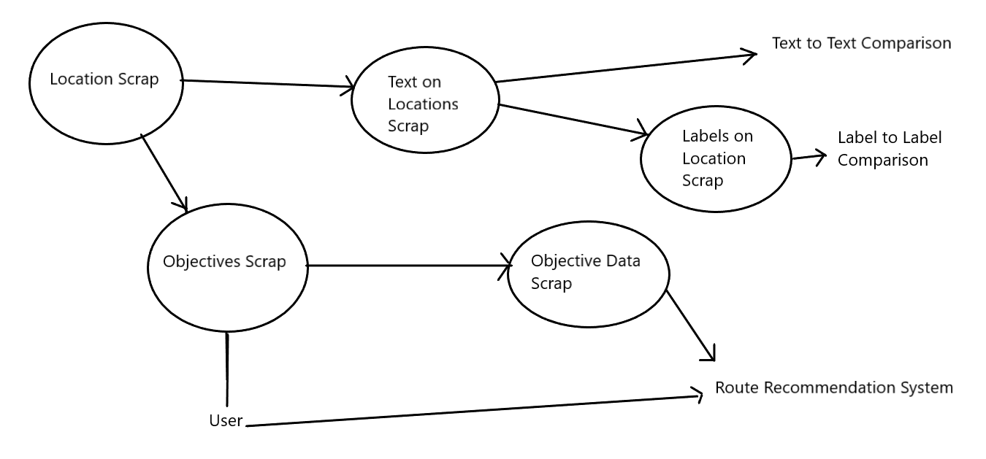
2. Happy flows and Mockups

Slide 5
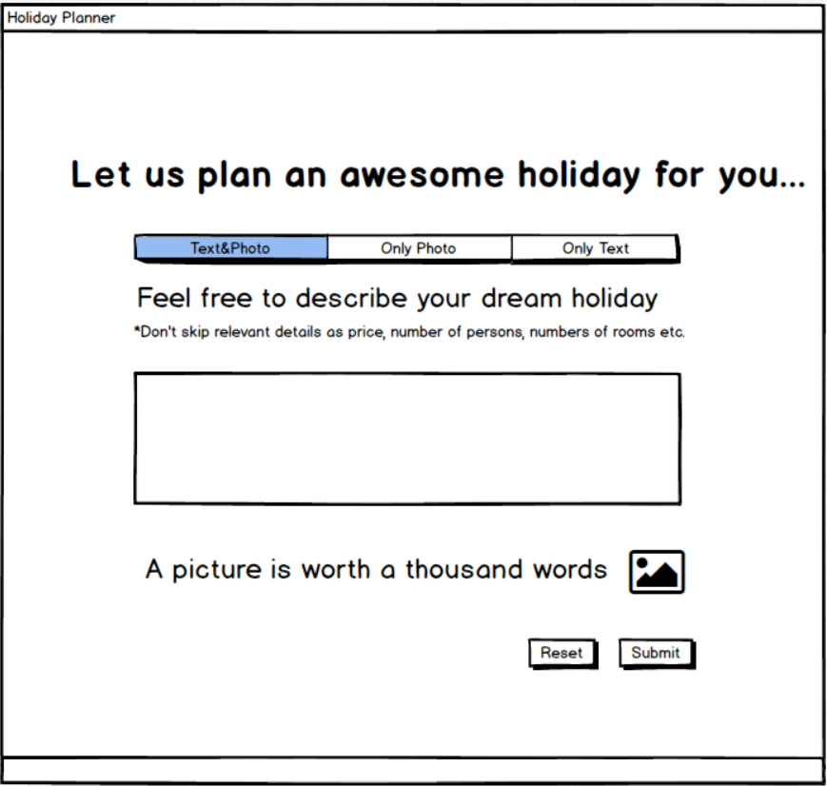
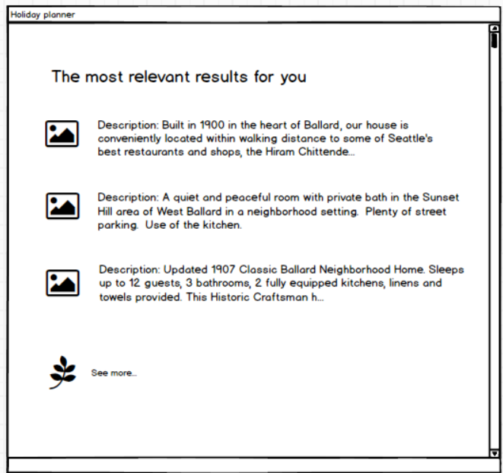
2. Happy flow and Mockups

Slide 6










3. Technologies & APIs
Data Scrapping
Image recommendation
Text recommendation
Route recommendation

Slide 7

4 . Web scrapping with python and beautiful soup
Scrapping for:
-Locations
-Text for every Location
-Objectives from every Locations
-Objectives details

Slide 8
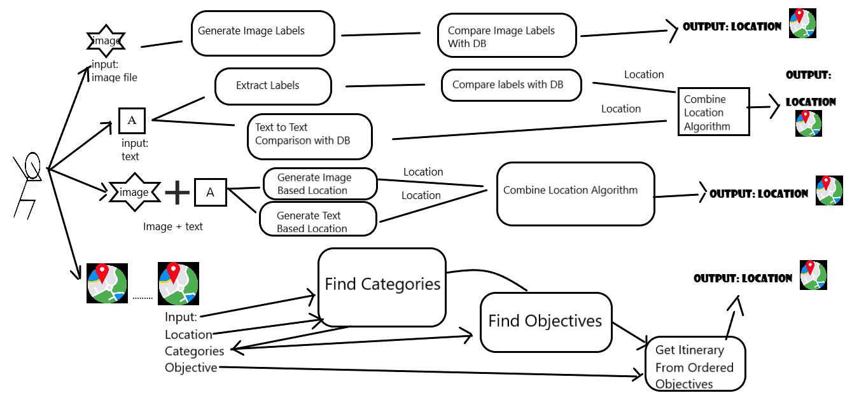
5.Business Logic

Slide 9
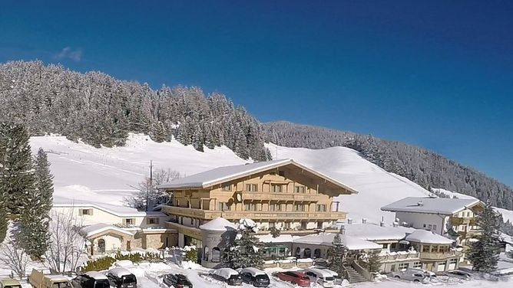
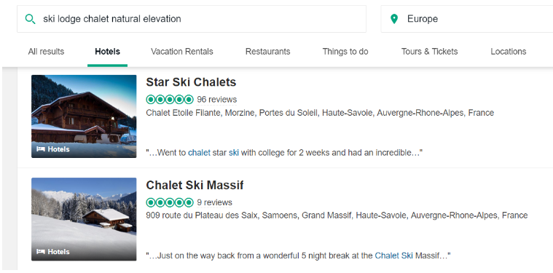
5. Business Logic: Image Recommendation
Intuition:
-label extraction using Watson Image Recognition API
-the API makes use of pretrained models
-gets labels with a fixed relevance: ski lodge,
natural elevation, chalet
-opens trip-advisor website to compare their
results with user’s image

Slide 10
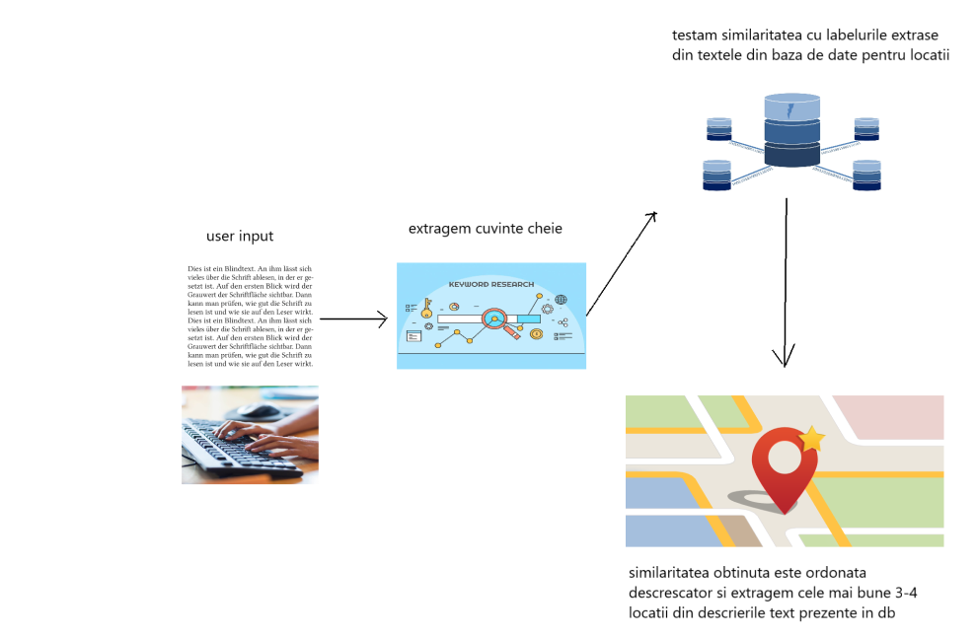
5. Business Logic:
Text Recommendation

Slide 11
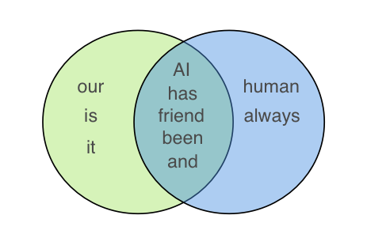
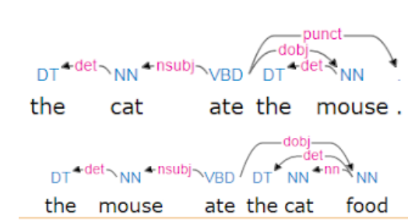
5. Business Logic:
Text Recommendation
Lexical Similarity
Intuition:
-computes similarity between two texts
using Parallel Dots API and returns a
number between [0,1]
-the API uses lexical and semantic similarity
-lexical similarity is computed at various granularity
-common metrics: Jaccard, Dice and Cosine
Semantic similarity

Slide 12
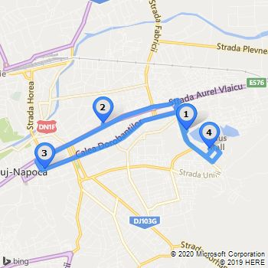
5. Business Logic:
RouteRecommendation
A few factors to consider:
- the schedule of every objective
- the necessary amount of time to visit an objective
- the priority of a location
the transition among locations
Algorithm usage: the automatization of the above steps

Slide 13
6.Future work
Database extension
Getting even more data from different sites. Extend the number of cities
Image Recommendation Improvement
Text Recommendation
Take into account the sentiment of a user’s input. Get named entities and and compute text classification
Next steps
Improve image recommendation algoritm
Language of the user
Mobile platform
Extend the approach to different languages, not only English
Create a mobile interface for clients

Slide 14

Team
Galan Radu
Hij Ancuta
Pricope Tidor
Szarvas Robert

Slide 15
Thank you

